Slide 1
LeakyFeeder: In-Air Gesture Control Through Leaky Acoustic Waves
${\text{Yongjie} \text{Yang}}^{1},{ \text{Tao} \text{Chen}}^{1},{ \text{Zhenlin} \text{An}}^{1},$ ${\text{Shirui} \text{Cao}}^{2},$ ${\text{Xiaoran} \text{Fan}}^{3},$ ${\text{Longfei} \text{Shangguan}}^{1}$
${}^{1}$University of Pittsburgh, ${}^{2}$University of Massachusetts Amherst, ${}^{3}$Google
Notes:
Hi everyone, I’m Yongjie from the University of Pittsburgh. I’m really excited to be here today to share our recent work, LeekyFeeder: In-Air Gesture Control Using Leaky Acoustic Waves. This project is a collaboration between our team, researchers at UMass Amherst, and Google.

Slide 2
Unintended, Yet Ubiquitous: Leaky Acoustic Signals in Earphones
Why does this leaky signal from earphones always happen?
Notes:
So you might be wondering — there are all kinds of leaky sounds around us, such as the hum from your laptop fan, or even traffic noise outside. But the kind of leakage we’re interested in comes from your earphones or headphones.
[x]For example, imagine you’re on a flight, and the person close to you is wearing one headphone. Unintentionally, you can hear the music leaking out — that’s the kind of leaky acoustic signal we’re focusing on, even the man whose wearing the earphone did not notice that
[x] Why is leaky sound so common in everyday life？

Slide 3
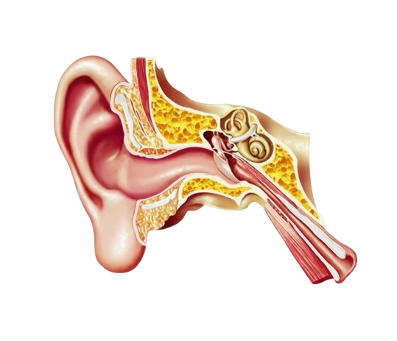
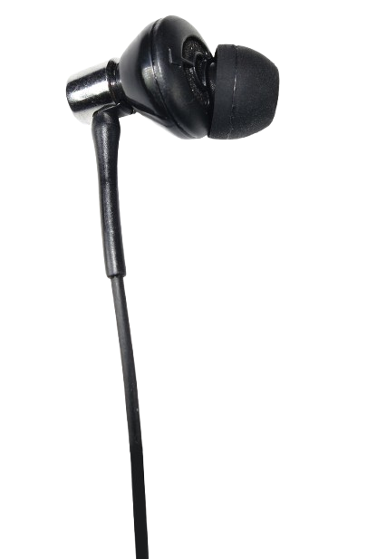
Get to Know Your Earphones and Your Ears
Most sound reflects off the ear canal walls, and some inevitably leaks out.
Notes:
Well, to answer that, let’s take a closer look at how this leakage actually happens when we wearing the earphone.
When sound is played through earphones, it travels into your ear canal — but not all of it reaches your eardrum.
Some of it bounces around inside, and only part of it can absorbed. [x]The rest escapes , especially if your earphones aren’t well sealed in your ears.

Slide 4
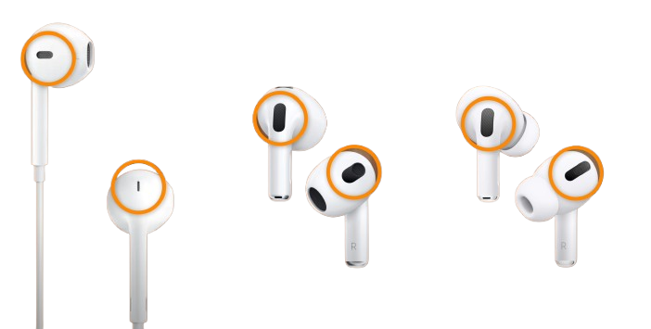
Get to Know Your Earphones and Your Ears
Most sound reflects off the ear canal walls, and some inevitably leaks out.
Manufacturers add pressure vents to balance ear pressure, but this design inevitably leaks audio.
Enables the feed-forward mic to capture ambient noise for ANC.
Helps equalize pressure for better sound quality.
Notes:
Now, even if we seal the earphones tightly in our ears — or use over-ear headphones to block out sound — there’s still one thing we can’t avoid.
[x]Take a look at this image. No matter which generation of AirPods you’re using, you’ll notice a tiny little vent on the side. Have you ever wondered what it’s for?
There are actually two reasons: [x]First, it helps the feed-forward microphone pick up outside noise for active noise cancellation. And second, it’s there to equalize pressure inside the ear canal and outside, which improves sound quality.
However, that same vent also gives the sound a way to leak out.

Slide 5
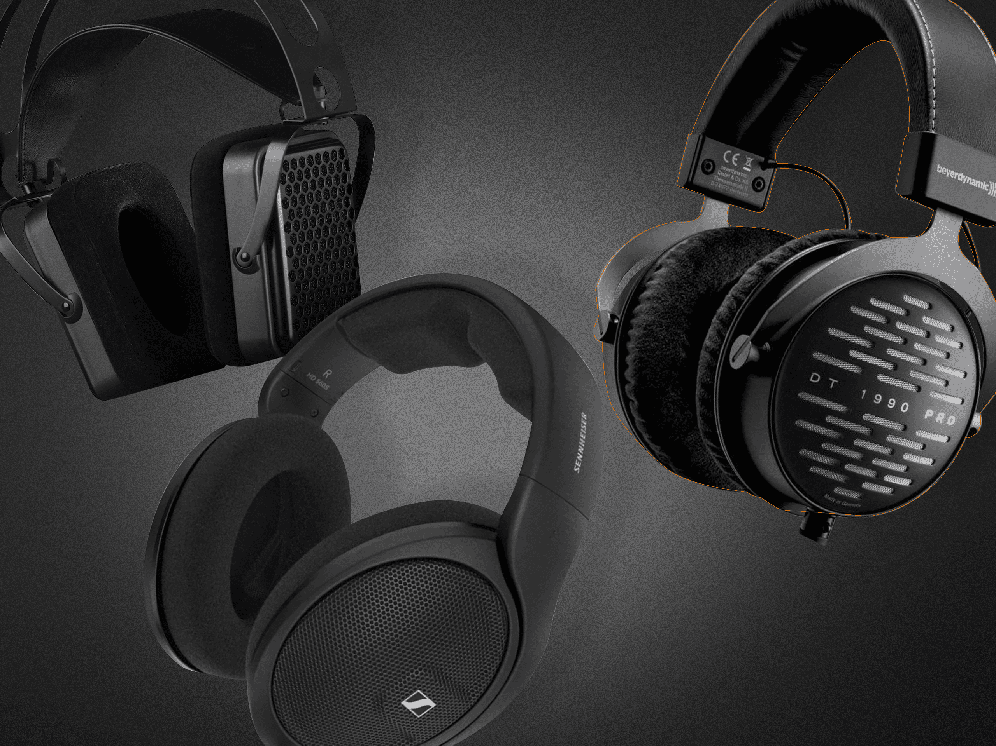
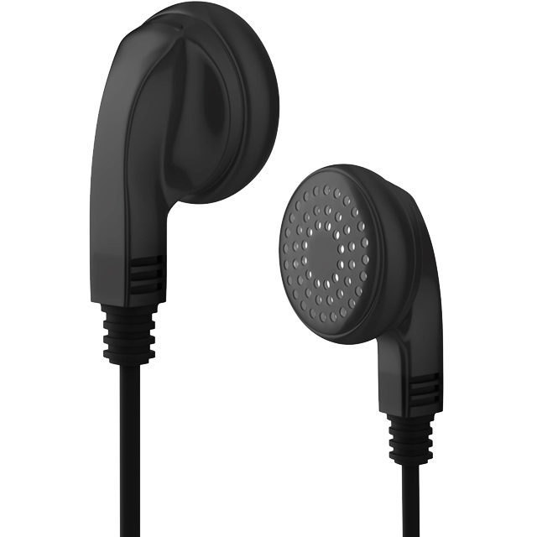
Get to Know Your Earphones and Your Ears
Most sound reflects off the ear canal walls, and some inevitably leaks out.
Manufacturers add pressure vents to balance ear pressure, but this design inevitably leaks audio.
Certain headphones naturally leak sound for a more open listening experience or due to low-cost materials.
Open-back Design
Low-cost earphones
Notes:
there are also some headphones that are just designed to leak sound.
Take a look at these examples:
On the left are open-back headphones, which leak sound by design to create a more natural listening experience. On the right are low-cost earphones, which leak sound due to cheap materials and poor sealing.

Slide 6
Can we turn leaky acoustic signals into a useful sensing resource?
Notes:
Since we can’t avoid these leaky acoustic signals phenomene— what if we could actually use them for some sensing task?

Slide 7
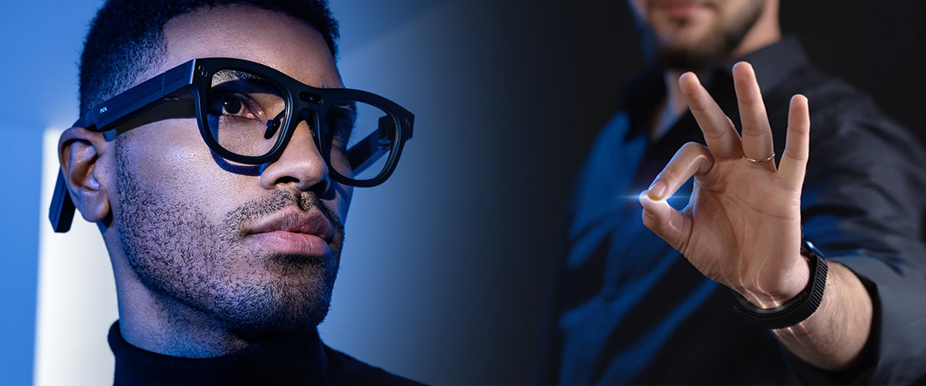
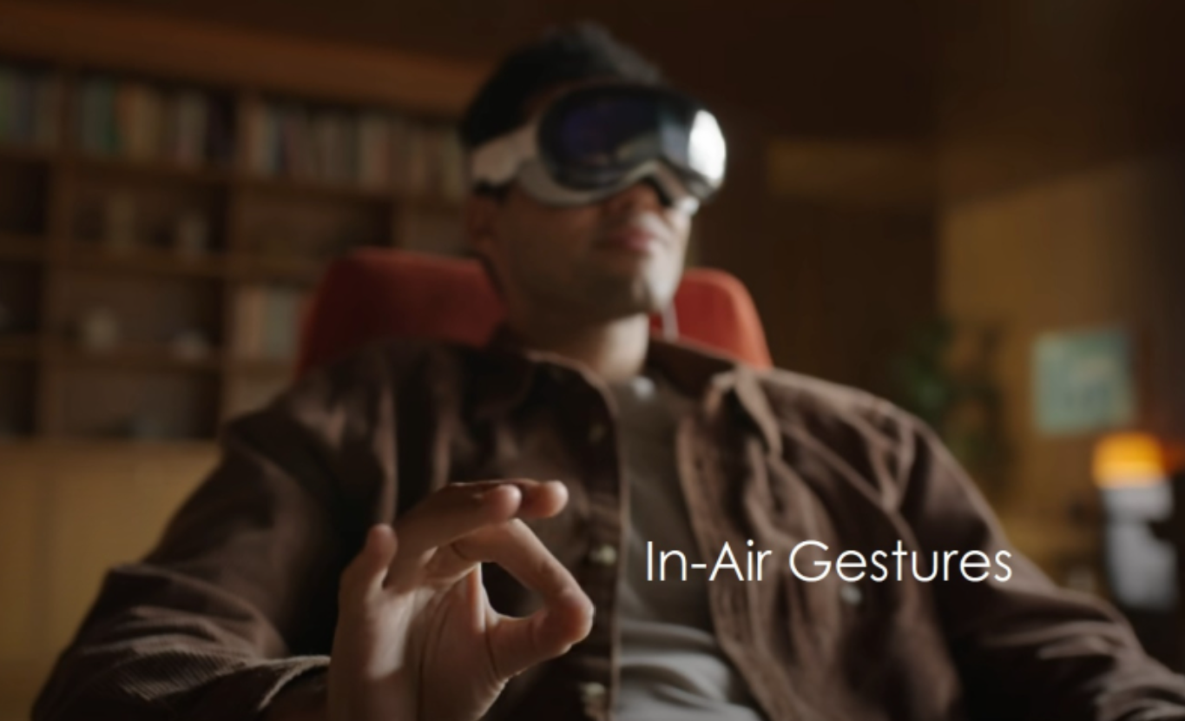
In-air gestures are emerging as a popular new interface for human-computer interaction.
Notes:
in this paper, we foused on one interaction task, the in-air gesture reconstruction,
[x]In fact, in-air gestures are becoming a hot trend — especially with devices like Apple Vision Pro and AR smart glasses. They're changing how we interact with machines — no need to touch a screen, just wave or pinch in the air.

Slide 8
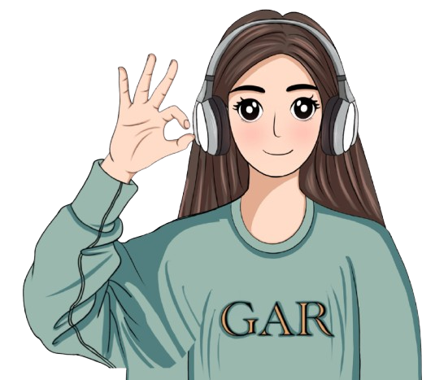
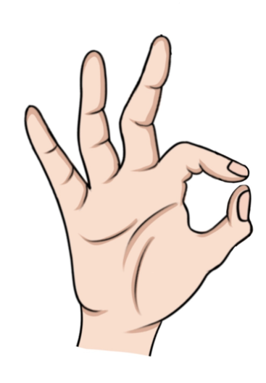
FMCW SONAR-Based Hand-to-Earphone Distance Sensing
Notes:
Technically, We use FMCW ranging to measure how far your hand is from the earphone while you're performing gestures.
[x] Specifically, following the CDC's hearing loss protection guidelines, we transmit an 82 dBA ultrasonic chirp to detect hand proximity — up to 15 cm away.
[x] Then we use the feed-forward microphone, which is typically found on ANC headphones.
[x] Here, we wire it out and repurpose it to capture the reflected signals. And we called this FMCW SONAR-Based detection.

Slide 9
FMCW SONAR-Based Hand-to-Earphone Distance Sensing
Using 82 dBA Chirps[1] to Detect Hand Proximity up to 15 cm
Feed-Forward
Microphone
Earphone-Driven FMCW Ranging
Using 82 dBA Chirps[1] to Detect Hand Proximity up to 15 cm.
[1]NIOSH, Noise and Hearing Loss Prevention, CDC, https://www.cdc.gov/niosh/noise/about.html.
Notes:
Technically, We use FMCW ranging to measure how far your hand is from the earphone while you're performing gestures.
[x] Specifically, following the CDC's hearing loss protection guidelines, we transmit an 82 dBA ultrasonic chirp to detect hand proximity — up to 15 cm away.
[x] Then we use the feed-forward microphone, which is typically found on ANC headphones.
[x] Here, we wire it out and repurpose it to capture the reflected signals. And we called this FMCW SONAR-Based detection.

Slide 10
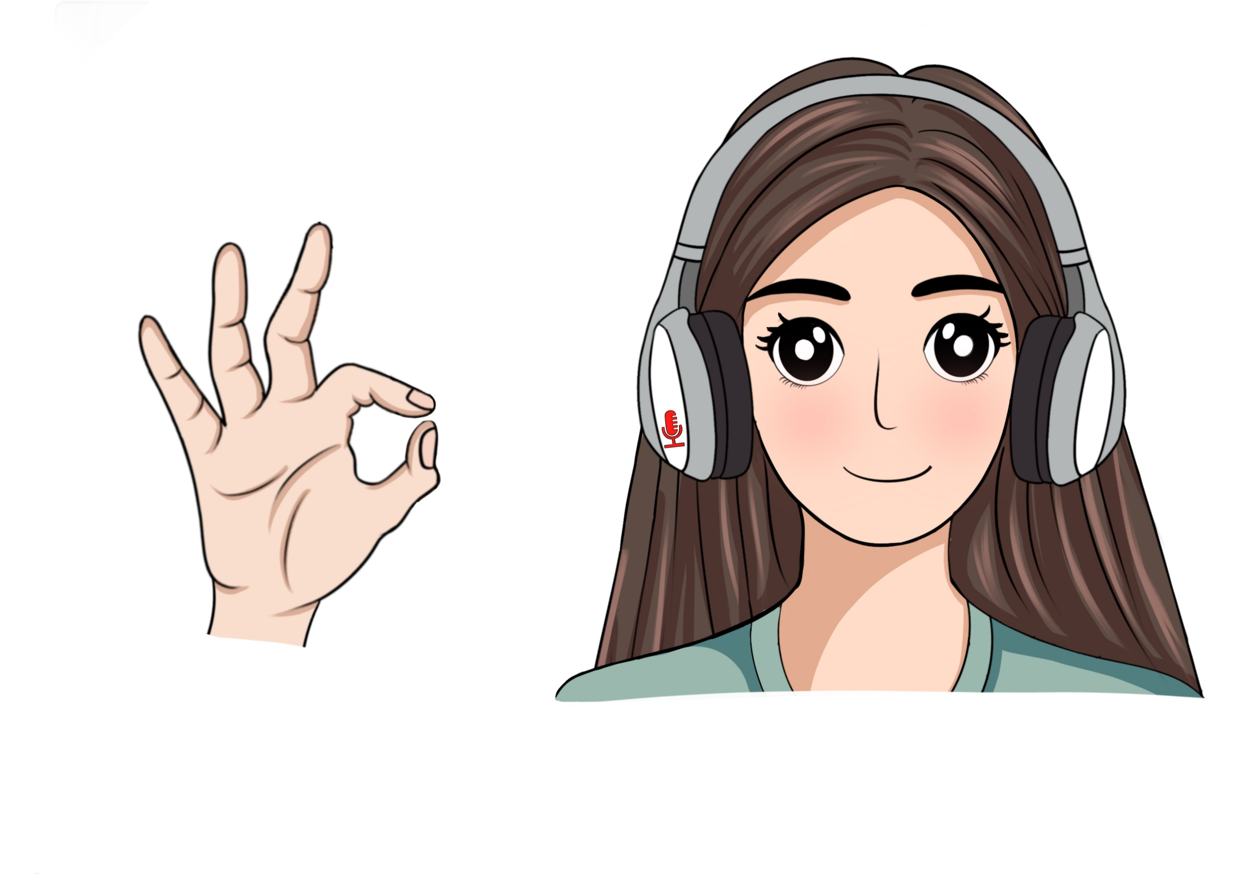
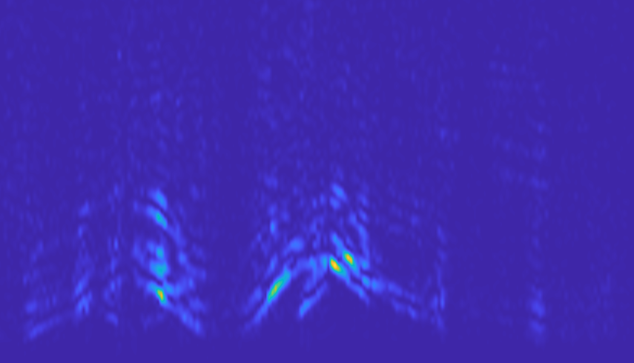
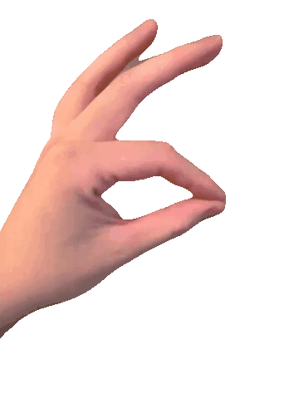
FMCW SONAR-Based Hand-to-Earphone Distance Sensing
14
12
10
Range (cm)
8
6
4
2
0
1
2
3
4
Time (s)
Notes:
So, let me show you an example, this rubbing gesture in the results. [x]On the right, the blue figure shows the reflections over time — the x-axis represents time, and the y-axis represents the detection range.
You can see that at different time points, we’re picking up different reflections from various parts of the hand. Also, we intentionally ignore signals within 2 cm to avoid reflections from the ear canal itself.
[x] This orange circle shows how even tiny rubbing gesture can be tracked over time, overall, overall the results shows how sensitive of our system to detect your find-graned gestures.

Slide 11
However, single-transceiver FMCW SONAR suffers from path ambiguity.
Notes:
However, you can see from our hardware setup, we only have one single microphone and one single speaker
[x]this raised some challenges about gesture reconstruction of path ambiguity issue.

Slide 12
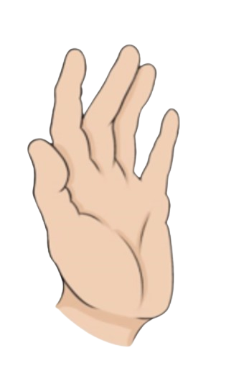
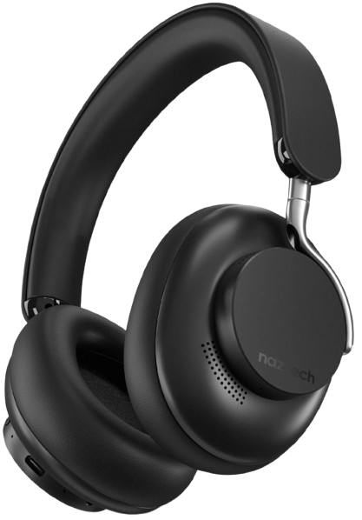
Too Many Echos, Too Little Clarity. - The Challenge of Multipath Ambiguity
How can we distinguish which echo corresponds to which part of the hand?
Microphone
Notes:
So the first challenge is that there are too many reflection echoes coming from different parts of your hand and it’s hard to tell which echo comes from which part.
[x] You can see that all the different echoes are picked up by a single microphone, so the signal we receive is actually a combined mix of reflections from various parts of your hand.
[x] How can we distinguish which echo corresponds to which part of the hand?

Slide 13
You can measure the distance, but not the direction. - The limitation of Angular Resolution
10cm
How can we localize the hand only at a distance?
10cm
10cm
Microphone
Notes:
The second challenge is directional ambiguity — even if different hand positions are at the same distance from the earphone, [x]it’s hard to tell which direction the signals are coming from. [x]In other words, we need some way to estimate the overall position of the hand.
So Based on these two challegens, this seems like a hard problem

Slide 14
Design Insights
Gesture Orientation Prior
“the palm typically faces the ear or headphone, with fingers pointing either upward or toward the ear.”
Ergonomic Joint Constraints
“ the finger joints bend naturally toward the palm when performing gestures.”
Motion Continuity
“each finger movement of the FMCW frame follows previous motions, avoiding abrupt shifts.”
Notes:
but luckily, we found some useful prior knowledge about how people naturally perform gestures in realworld scenario and that’s what inspired our data-driven model in the later.
Let me walk you though these insight knowledge
first, we have the gesture orientation prior. When people perform gestures around the ear, the palm usually faces the headphone, with fingers pointing either upward or inward. This can gives us a rough directional assumption to work with.
[x] Taking it a step further, second, we also consider ergonomic constraints. The human hand moves in a predictable way — finger joints naturally bend toward the palm, which in this case means your fingers tend to bend toward the ear side.
So, even if we can’t see the exact pose, we know certain positions are more likely than others.
[x] and most importantly, there’s motion continuity. When performing gestures, finger movements don’t just randomly jump — they follow smooth, continuous trajectories. That means we should take continuous frames to see the temporal patterns in the FMCW signal sequence.

Slide 15
FMCW SONAR-Based Hand Reconstruction Model Architecture
Notes:
So we build a FMCW SONAR-Based Hand Reconstruction Model Instead of building a new model from scratch, we adapted some architectures for cross-modal translation to translate our audio ranging input to the vision domain to reconstruct the each hand joint
And then we levareing the transoformer model, which performs very well in time sequence data as we know, and also designed some key compnonents in our architecture.

Slide 16
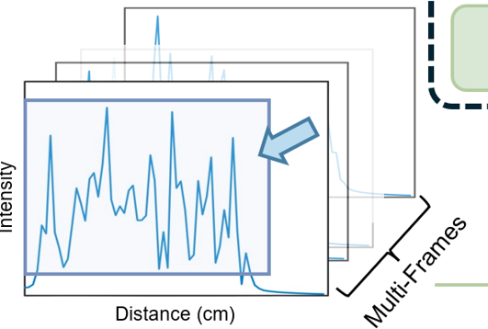
Input: Multi-frame FMCW Distance Sequences
Encode gesture motion over time, not just a single ambiguous frame.
Provide temporal context to help resolve multipath overlaps.
Capture reflection intensity over distance (but no direction).
Notes:
Let me first talk about the input This temporal Multi-frame FMCW Distance Sequences allows the model to learn how reflections shift smoothly across time, which helps disentangle overlapping echoes from different hand parts. Instead of treating each frame independently, it also learns the motion continuity — enabling better reconstruction of gesture trajectories.

Slide 17
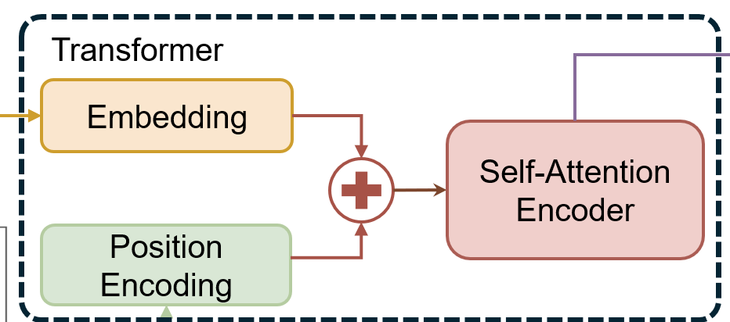
Transformer Encoder
Embedding + position encoding learns spatial-temporal patterns.
Self-attention models motion continuity and finger trajectory.
Addresses both angular ambiguity and echo mixing via time modeling.
Notes:
To model how hand motion over time, we use a Transformer encoder. It starts with position encoding to inject frame order into the data — allowing the model to capture temporal dynamics. Then, the embedding layer extracts rich features from each FMCW frame, and finally, self-attention links those frames together, learning both spatial and motion patterns to resolve ambiguity and reconstruct gestures.

Slide 18
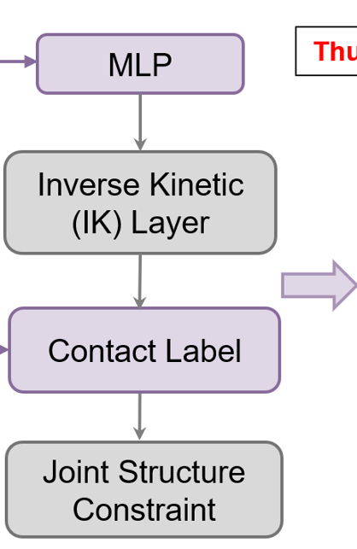
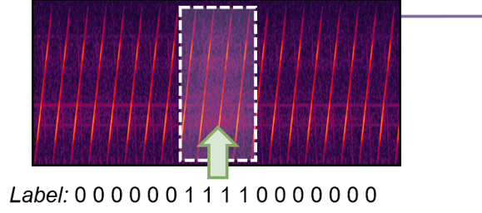
Output Reconstruction & Refinement
Predicts anatomically accurate 3D hand skeletons from learned features.
The Inverse Kinetic layer enforces realistic bone lengths and joint constraints.
Contact cues (e.g. friction sounds) refine fine-grained fingertip alignment.
Ensures smooth, natural, and structurally valid hand motion.
Notes:
Finally, we take the learned features and predict a 3D hand skeleton. To make sure the motion looks natural and physically valid, we add an Inverse Kinematics (IK) layer — this enforces realistic bone lengths and joint angles from our hand. We also use contact cues, like friction sounds, for example, such as rubbing gesture, to fine-tune fingertip alignment — ensuring smooth plausible gestures.

Slide 19
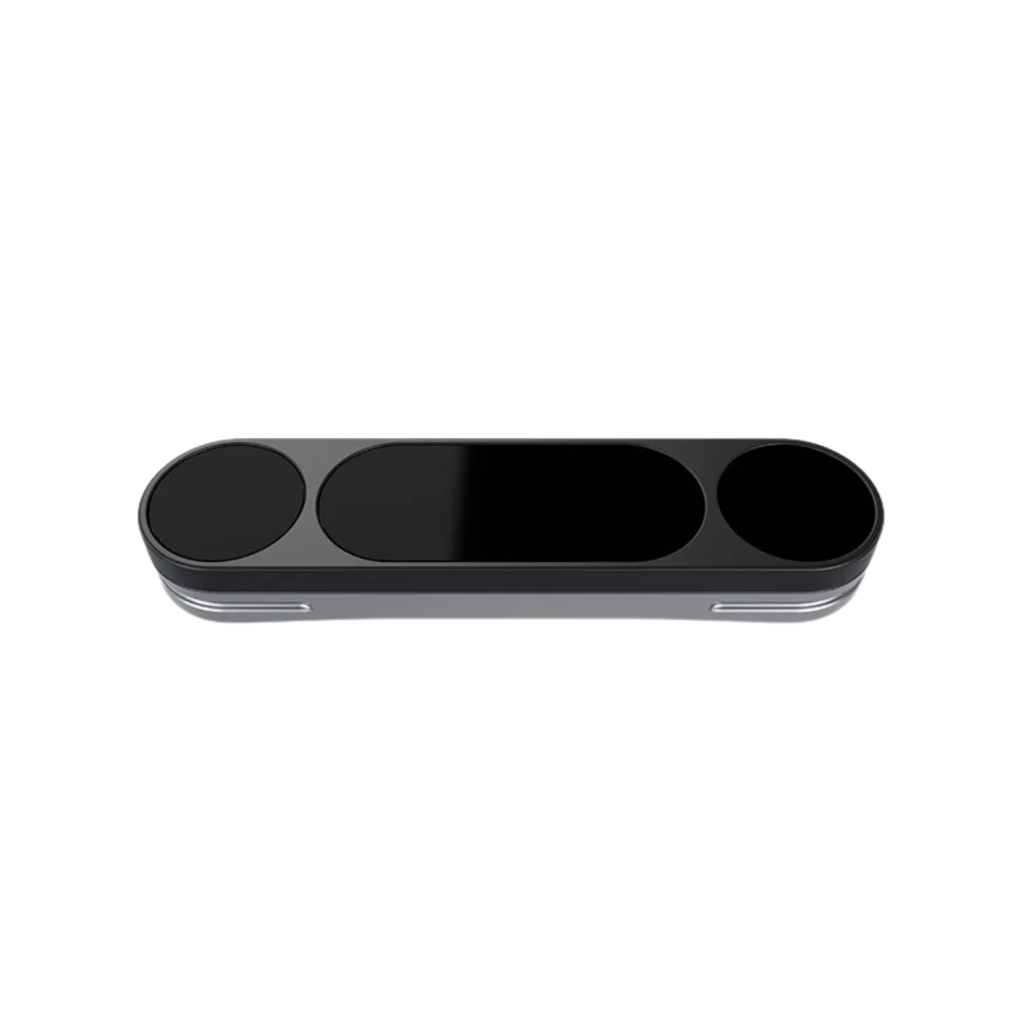
Evaluation: Example of a generated Double-Tapping gesture
2.5X slower
LeakyFeeder
Groundtruth LeapMotion 2
More gesture reconstruction results can be found at: https://leekyfeeder.github.io/results
Notes:
Here is one visiualazion example from our system, [x] leeky feeder, and also from the commercial ground truth hand tracking from Leapmotion
The reconstructed results are quite reasonable, right?

Slide 20
Data Collection
Gesture Set: 6 gestures based on Apple Vision Pro standard.
Training Data:
We recruited volunteers who performed gestures over 100 times at various hand positions and angles around the ear using a dummy head setup.
Single Tap
Double Tap
Pinch and Hold
Pinch and Slide
Rub
Hand Close
Notes:
For training, we recruited volunteers to collect data and perform six gestures based on current Vision Pro standard gestures，repeat at different positions and angles around the ear.

Slide 21
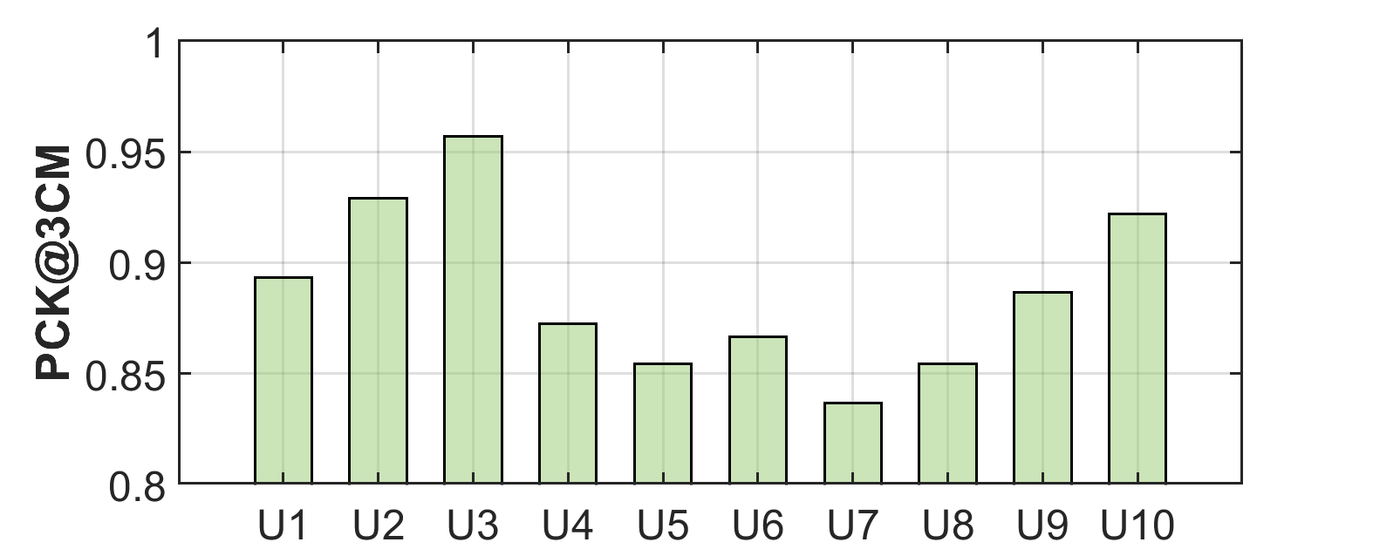
Evaluation: Gesture Reconstruction on Ten New Users
Different Users
LeakyFeeder achieves over 85% PCK@3cm, a standard metric for assessing keypoint accuracy within a tolerable error margin relative to hand size.
Notes:
To evaluated our system， we tested the model on 10 new users, each wearing Pixel Buds and performing the same gestures. [x]As you can see here, most users achieved over 85% accuracy within 3cm, which means the predicted hand poses closely match the real ones.
Now, you might notice a few bars fall below that red line —that’s mainly because some users had larger user hands, which out of the detection range, making the reconstruction task harder.

Slide 22
Conclusion
Leaky Ultrasound as a Signal Source: We exploit naturally leaked ultrasonic waves from ANC earphones—an often-overlooked byproduct—as a free sensing channel.
Echo-to-Gesture Reconstruction: These weak echoes are decoded into fine-grained 3D hand skeletons using FMCW processing and a temporal Transformer model with physical priors.
Reliable Performance Without Extra Hardware: Our system achieves 89% PCK@3cm across diverse users and gestures, using only commercial ANC earphones.
Notes:
So in short summary—first, we turn the usually we ignored leaky sound from ANC earphones into a sensing signal,
Then, we decode those weak echoes into 3D hand gestures using FMCW and a Transformer.
And finally, we hit 89% accuracy within 3cm—across different users, and different gestures, which is empowering your user experience by using the daily ANC earphones.

Slide 23
Thanks for Listening!
Yongjie Yang
Email: yoy28@pitt.edu

